Slide 1



Predicting Solar Power Output Using Linear Regression

Slide 2

Learning Objectives
1. Understanding Solar Power and Its Influencing Factors
2. Introduction to Linear Regression
3. Data Collection and Preprocessing
4. Implementing Linear Regression for Solar Power Prediction
GOAL
5. Model Evaluation and Optimization
6. Real-World Applications and Insights
Source :
www.freepik.com/

Slide 3
Tools and Technology used
1. Programming Language : Python
2. Libraries and Frameworks :
Pandas – Data manipulation and preprocessing.
NumPy – Numerical operations and handling large datasets.
3. For Machine Learning & Regression Modeling :
Scikit-learn – Linear regression modeling, evaluation metrics, and preprocessing.
TensorFlow.js – Implementing regression models in the browser.
Statsmodels – Advanced statistical modeling and in-depth regression analysis.
4.For Data Visualization :
Matplotlib & Seaborn – Data exploration and correlation analysis.
5. Development Environments :
Jupyter Notebook / Google Colab – For prototyping and interactive coding.
VS Code / PyCharm – For full-fledged development.

Slide 4
Methodology
Step 1: Define the objective: Predict solar power output based on weather conditions (e.g., sunlight hours, temperature, cloud cover).Identify the independent variables (features) and dependent variable (target):Features: Temperature, humidity, solar radiation, wind speed, cloud cover, time of day.Target: Solar power output (in kW or MW).
Step 2: Data Preprocessing & ExplorationHandling Missing Data: Impute missing values using mean, median, or interpolation.Outlier Detection: Identify and remove anomalies using box plots or z-score analysis.Feature Engineering:Convert categorical data (e.g., weather conditions) into numerical format.Create new features (e.g., solar panel angle, moving averages of past sunlight levels).Data Normalization: Scale numerical features using Min-Max scaling or Standardization.Exploratory Data Analysis (EDA):Use correlation matrices (heatmaps) to check relationships between variables.Visualize feature distributions using histograms, scatter plots, and box plots.
Step 3: Model Evaluation & OptimizationEvaluate the model using performance metrics:Mean Absolute Error (MAE) – Measures average error.Mean Squared Error (MSE) – Penalizes larger errors.R² Score – Measures how well the model explains variations in data.Optimization Techniques:Feature Selection: Remove low-impact features.Polynomial Regression: Capture non-linearity in data.Regularization (Lasso, Ridge Regression): Prevent overfitting.
Step 4: Model Selection & ImplementationChoose Linear Regression as the base model:Simple Linear Regression (if predicting output based on one factor, e.g., solar radiation).Multiple Linear Regression (if multiple factors affect the output).
Step 5: Model Monitoring & UpdatesContinuously update the model with new real-time data.Implement feedback loops to improve accuracy.Automate model retraining using scheduled updates.

Slide 5
Problem Statement:
Predicting Solar Power Output Using Linear Regression

Slide 6
Solution:
1.Data Collection & Preprocessing – Gather weather and solar power data, clean missing values, normalize features, and perform exploratory data analysis.
2.Feature Selection & Engineering – Identify key factors (e.g., sunlight, temperature, cloud cover) and create meaningful features for accurate predictions.
3.Model Training & Implementation – Use Multiple Linear Regression, train on historical data, and analyze feature coefficients for insights.
4.Model Evaluation & Optimization – Assess performance using R² score, MAE, and MSE, optimize with feature selection, and apply regularization if needed.
5.Deployment & Integration – TensorFlow.js, or Plotly.js, integrate with StatAnveshak for real-time interactive predictions.

Slide 7
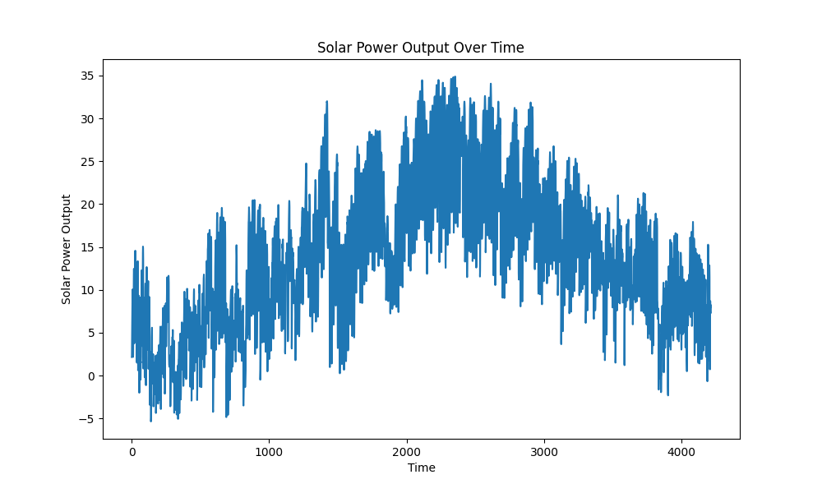
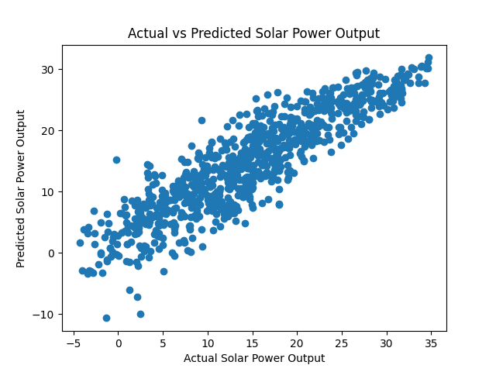
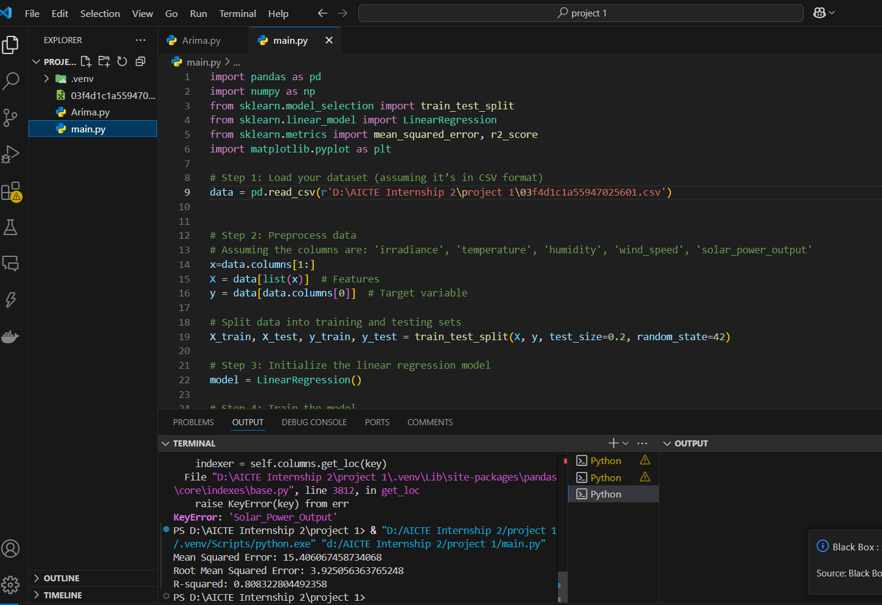
Screenshot of Output:

Slide 8
Conclusion:
Predicting solar power output using linear regression provides an efficient way to estimate energy generation based on weather conditions. By leveraging historical data, selecting relevant features, and optimizing the model, we can achieve accurate predictions. This helps in energy planning, grid optimization, and improving solar panel efficiency. Deploying the model in a web-based tool like StatAnveshak can enhance accessibility and real-time decision-making for students, researchers, and engineers. 🚀

